Slide 1
Module 4: Descriptive analysis and identification of hotspots
Michael Otterstatter, PhD
Analytic Capacity Building Initiative:
Workshop in Geospatial Methods
September 17-18, 2019, Calgary, Alberta

Slide 2
Outline
Background and concepts
  Clustering and detection of clusters
  Global spatial autocorrelation
  Local spatial autocorrelation
  Cluster detection methods
Illustrative example
  R script: Descriptive analysis and spatial autocorrelation
  R script: Detecting spatial clusters
References and other resources

Slide 3
Background and concepts

Slide 4
Clustering and detection of clusters
Background and concepts
Public health data are often available by administrative regions, as opposed to point locations, for example:
  census geographies: e.g., subdivisions or dissemination areas
  postal code areas: e.g., forward sortation areas and 6-digit postal codes
Here, we consider measurement of clustering and detection of clusters in data organized and aggregated into administrative regions
We make use of corresponding population sizes, for calculation of rates (events/population) and expected numbers of events in a region
Recall relevant cautions: e.g., ecologic fallacy, modifiable areal unit problem (MAUP), and trade-off between resolution and sample size

Slide 5
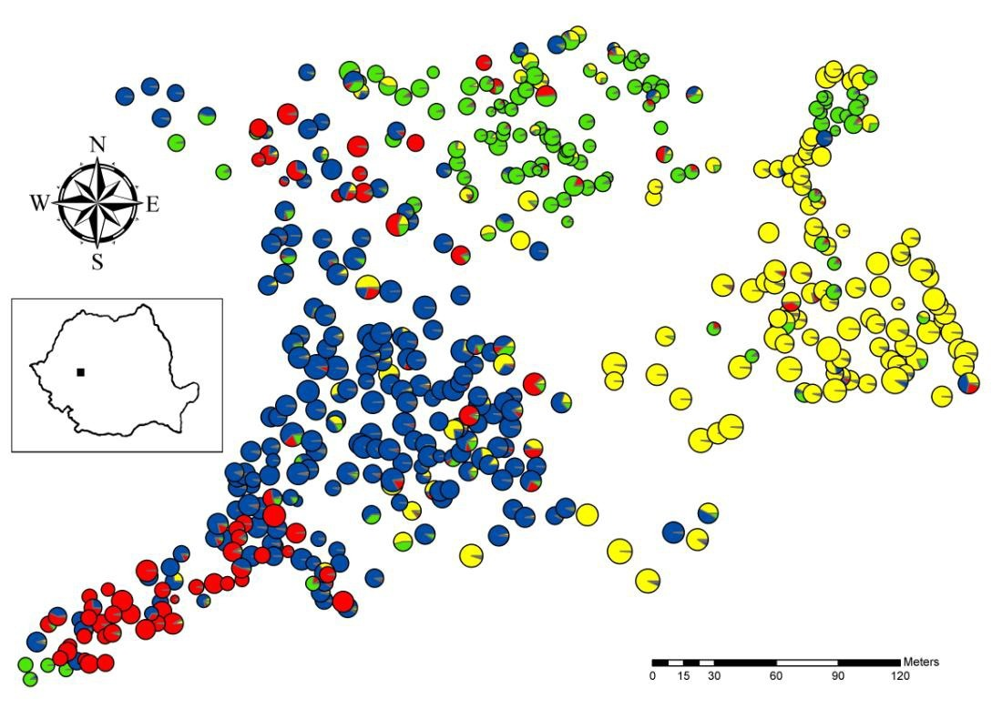
Clustering and detection of clusters
Background and concepts
With clustering, we are interested in measuring if, and how much, events are aggregated in space across an area of interest (global patterns)
With detection of clusters, we are interested in identifying specific regions that form an unusual spatial aggregation of events (local patterns)

Slide 6
Clustering and detection of clusters
Background and concepts
Measures of spatial autocorrelation are often used to
  describe spatial patterns of events across an entire study area (global spatial autocorrelation – a measure of clustering), or
  provide an indication of each region’s similarity (in events) to its neighbouring regions (local spatial autocorrelation – detection of clusters)
Many measures of global and local spatial autocorrelation exist, but they tend to have a common formulation

Slide 7
Global spatial autocorrelation
Background and concepts
The common calculation of global spatial autocorrelation is the cross-product of two matrices:
  values of similarity (in event counts) between each pair of regions; and,
  values indicating proximity (distance, neighbouring, etc.) between each pair of regions
high cross-product values (similar regions close together) indicate positive spatial autocorrelation
small values (dissimilar regions close together) indicate negative spatial autocorrelation

Slide 8
Global spatial autocorrelation
Background and concepts
Positive spatial autocorrelation Spatial randomness Negative spatial autocorrelation

Slide 9
Global spatial autocorrelation
Background and concepts
One of the most common measures of global spatial autocorrelation is Moran’s I, which is a spatially weighted version of the standard Pearson’s correlation coefficient
Global Moran’s I statistic

Slide 10
A note on spatial proximity
Background and concepts
Calculating spatial autocorrelation requires a measure of proximity between each pair of regions (spatial weight matrix or spatial proximity matrix)
Proximity values may be
  pairwise distances between regions, or
  binary indictors (0/1) of whether or not two regions are considered neighbours (e.g., sharing a border, within a defined distance, within the set of k nearest regions, etc.), or
  weights to reflect relative importance of each neighbour (e.g., assign a weight of 1/5 to each of the five neighbours of a particular region)

Slide 11
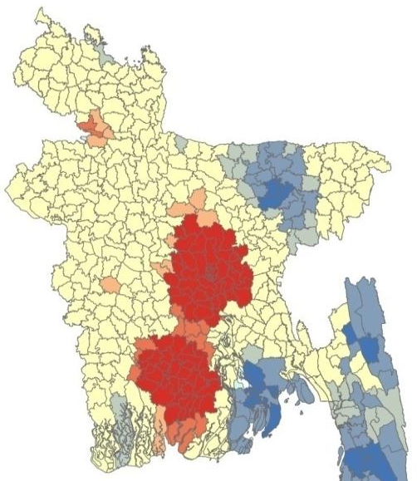
Local spatial autocorrelation
Background and concepts
Global autocorrelation does not detect clusters per se, so we utilize local measures of spatial autocorrelation to find aggregations of events
Local measures indicate each region’s similarity to its neighbours (e.g., in event counts)
Often we map local measures of spatial autocorrelation to assist in the detection of ‘hotspots’ or ‘cold spots’ in an event of interest

Slide 12
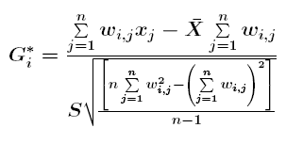
Local spatial autocorrelation
Background and concepts
As before, calculations of local metrics use similarity between a region and its neighbours, weighted by proximity of those neighbours
Common local measures of spatial autocorrelation include local Moran’s I and Getis-Ord G
Local Getis-Ord G_{i}* statistic

Slide 13
Cluster detection methods
Background and concepts
Many methods exist for cluster detection (see Fotheringham and Rogerson, 2008) – here we only introduce scan statistics as an illustration of concepts and methodology
a spatial scan can be used identify groups of events in a study area that are statistically unlikely (given the null hypothesis of no clustering) and test whether and to what degree these groups are statistically significant
spatial scans are the foundation of the freely available software package SaTScan: https://www.satscan.org/)

Slide 14
Cluster detection methods
Background and concepts
Several spatial scan statistics exist -- For regional event counts, the general methodology is:
  spatial scan creates expanding circles on locations within the study area, ranging from smallest inter-centroid distance to specified upper bound (based on distance or population size)
  regions with centroids falling within circle have their events (and population sizes) included in analysis of that circle
  For each circle, observed and expected event counts are compared inside vs outside
  the circle with the greatest risk (inside compared to outside) is deemed the ‘most likely cluster’ and statistical tests of this cluster are done using simulation methods

Slide 15
Cluster detection methods
Background and concepts
Note, we can also use ellipses or user-specified scanning windows, rather than circles, in the spatial scan – these may be preferred depending on the shape of the study area and the distribution of events
Similar scanning methods may also be extended to test for temporal and spatio-temporal clusters of events

Slide 16

Considerations and cautions
Background and concepts
Statistical clusters of events may or may not be relevant to public health – the definition of a cluster should be discussed on a case by case basis
Statistical considerations, including corrections for multiple comparisons, need to be examined carefully when performing cluster detection

Slide 17
Illustrative example

Slide 18
Spatial autocorrelation in R
Illustrative example
R script: Descriptive analysis and spatial autocorrelation

Slide 19
Detecting spatial clusters in R
Illustrative example
R script: Detecting spatial clusters

Slide 20
References and resources
Fotheringham, A.S. and Rogerson, P.A., eds. 2008. The SAGE handbook of spatial analysis. Sage.

